Slide 1
Retail Store EDA & visualization

Slide 2
Agenda
Introduction and purpose
Data overview
Data Cleaning
EDA and Visualization
Deployment

Slide 3

Introduction : This Exploratory Data Analysis (EDA) project examines sales and customer trends for a retail store. By analyzing historical data, AIMING TO uncover patterns, and provide insights that can help improve business strategies. Through visualizations and statistical analysis, this study highlights important factors affecting sales performance and customer behavior.

Slide 4

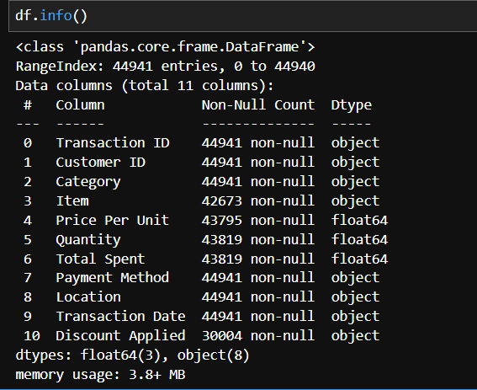
Data overview
Kaggle: https://www.kaggle.com/datasets/ahmedmohamed2003/retail-store-sales-dirty-for-data-cleaning
The dataset consists of 44,941 retail transactions with 11 columns covering key aspects of sales.

Slide 5
Transaction ID (Object, 44,941 non-null) – Unique identifier for each transaction.
Customer ID (Object, 44,941 non-null) – Unique identifier for each customer.
Transaction Date (Object, 44,941 non-null) – Date of the transaction.
Category (Object, 44,941 non-null) – Product category of the purchased item.
Item (Object, 42,673 non-null) – Specific item purchased (some missing values).
Price Per Unit (float64, 43,795 non-null) – Cost per unit of the item purchased.
Quantity (Float64, 43,819 non-null) – Number of units purchased in the transaction.
Payment Method (Object, 44,941 non-null) – Payment mode used (e.g., cash, card, etc.).
Location (Object, 44,941 non-null) – Store location where the transaction occurred.
Discount Applied (Object, 30,004 non-null) – Indicates if a discount was applied (many missing values).

Slide 6
Data Cleaning
Converted "Transaction Date" to datetime format to ensure accurate date-based analysis and time-based operations
Handled missing values in the "Discount Applied" column by replacing null values with False, ensuring consistency in discount data
Created a "Final Price" column by applying a 10% discount to transactions where a discount was applied, ensuring accurate final pricing.
Filled missing values in the "Price Per Unit" column by calculating the price using the "Total Spent" and "Quantity" columns, ensuring complete pricing data.
Dropped rows with missing values in the "Quantity" column where other key data (Item and Total Spent) were also missing, as this information cannot be recovered.
Created an item mapping based on "Category" and "Price Per Unit" to fill missing values in the "Item" column, ensuring accurate item categorization.

Slide 7
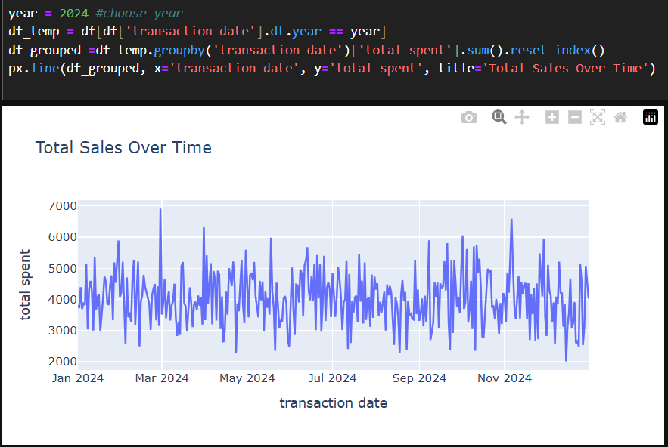
EDA and data visualization

Slide 8
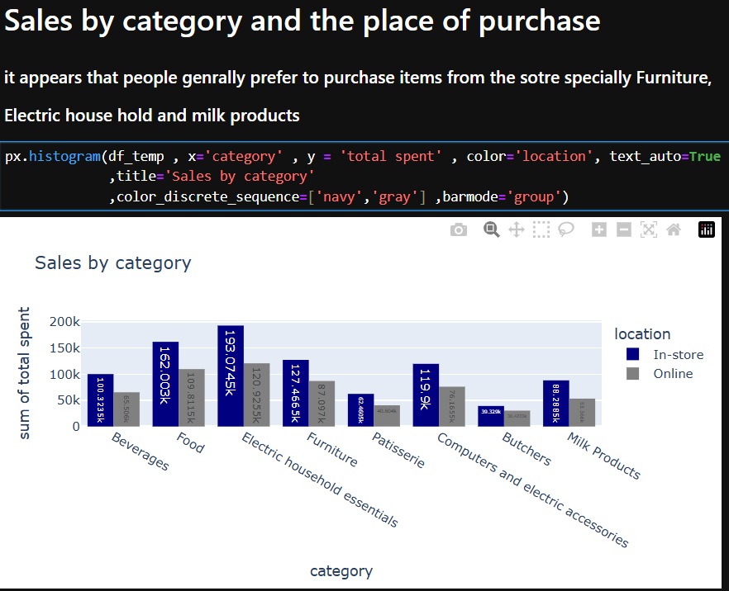
EDA and data visualization

Slide 9
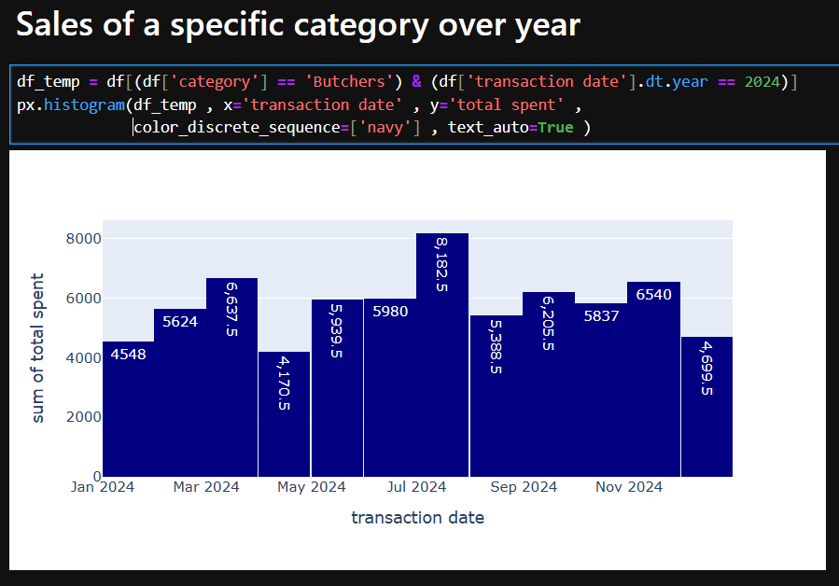
EDA and data visualization

Slide 10
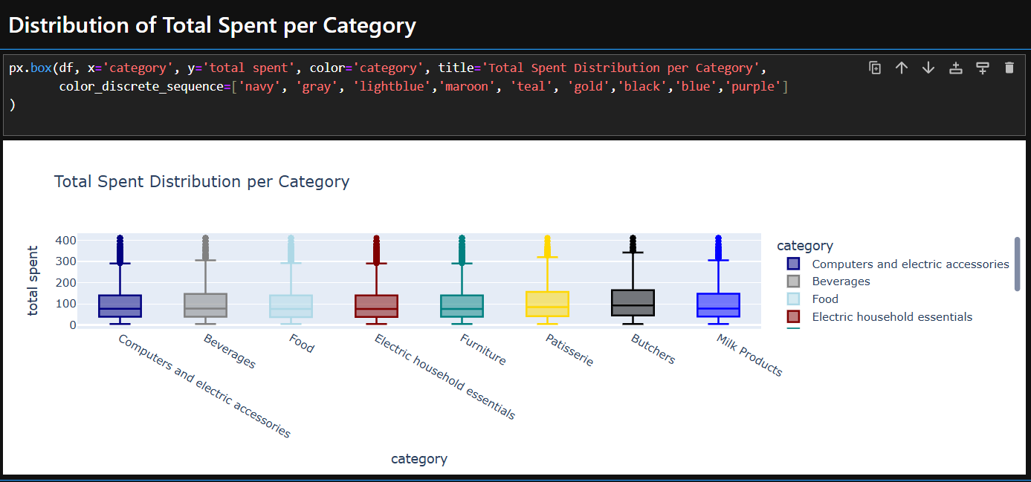
EDA and data visualization

Slide 11
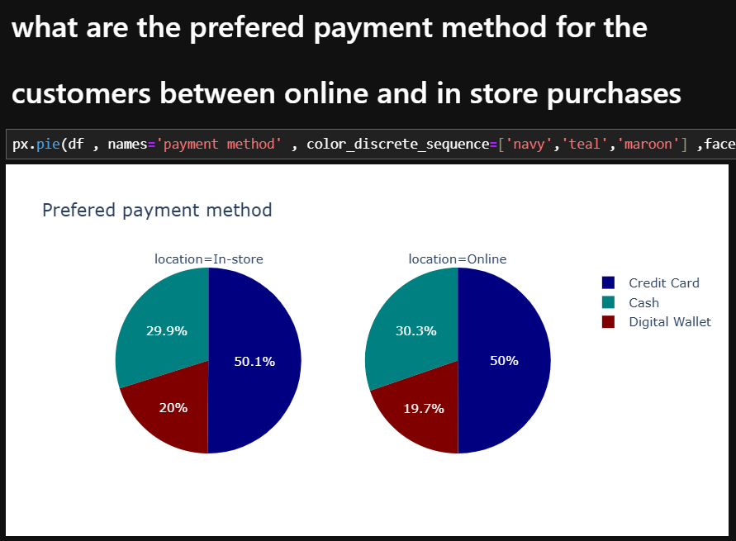
EDA and data visualization

Slide 12
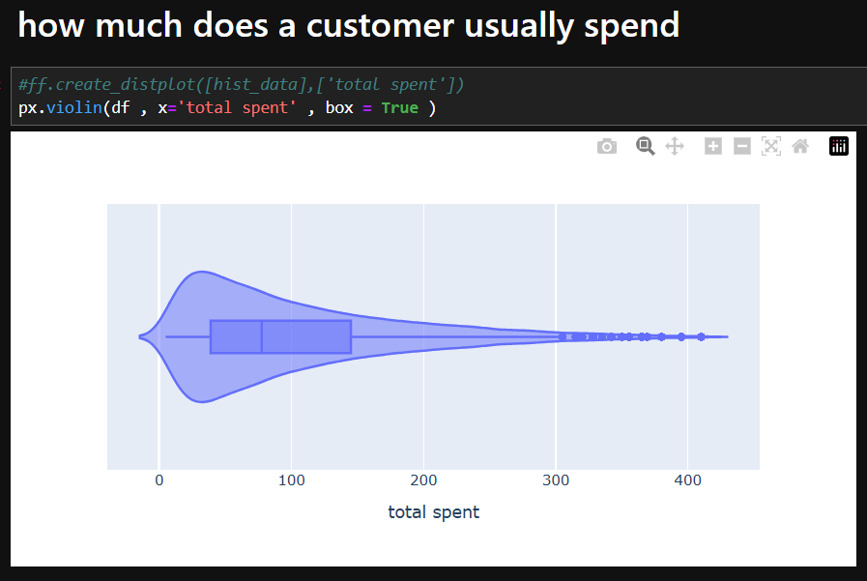
EDA and data visualization

Slide 13
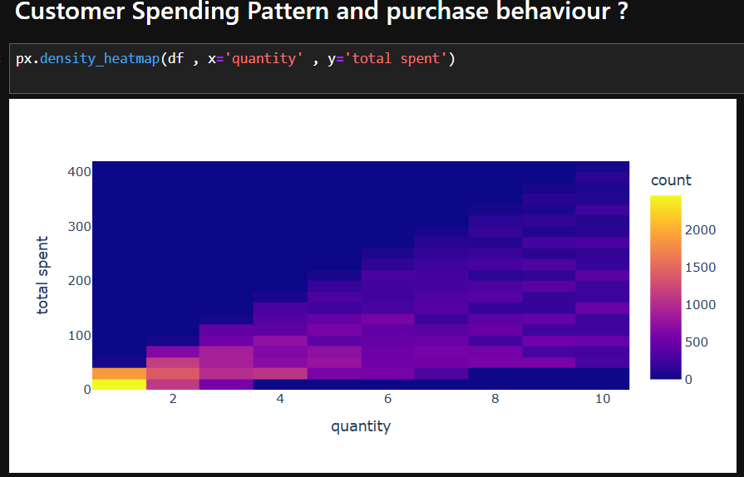
EDA and data visualization

Slide 14
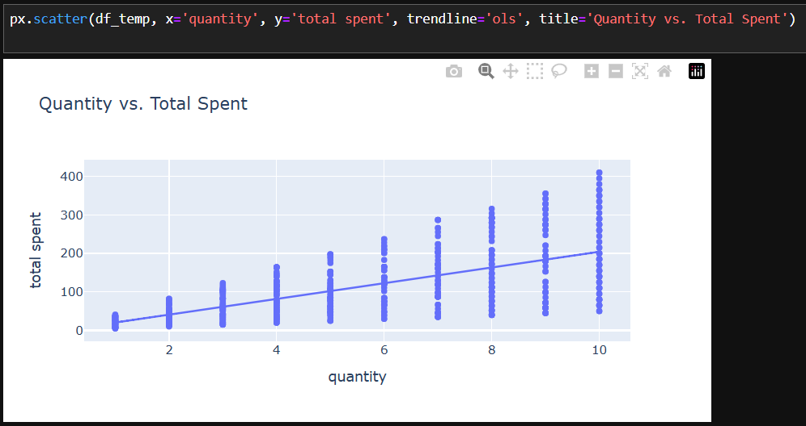
EDA and data visualization

Slide 15
Deployment
Deployed data visualizations in Streamlit to present insights interactively. This allows users to explore key metrics, trends, and patterns through dynamic charts and graphs.
Benefit: Streamlit enhances decision-making by providing real-time, user-friendly visualizations, allowing stakeholders to quickly analyze data and make informed business decisions.

Slide 16
THANK YOU
Mostafa Tarek Mohamed
Instructor: Tarek Ziad
Mostafa.tarek.abdeljawad@gmail.com

